Slide 1



short introduction

Slide 2
The Volunteer Support Centres in Italy
Volunteer support Centres (VSCs) were established by the Law 266/91. They are working facilities managed by the volunteering world offering free services to voluntary organizations.
They promote the culture of solidarity and active volunteering, facilitate and support the actions of voluntary organizations through consultancy, help, training and information services.
Present all over Italy, VSCs are financed by 1/15th of profits made by bank foundations (after management expenses and law duties) through the Special Fund for Volunteering, set up in every Region.

Slide 3
CSV Marche Volunteer Support Centres
CSV Marche is an organization of volunteering organizations that pursues the qualification of volunteering organizations on the territory of Marches Region.
CSV Marche membership base is around 400 volunteering organizations. They elect the Board, composed only by volunteers and it defines the political guidelines of volunteering organizations.

Slide 4
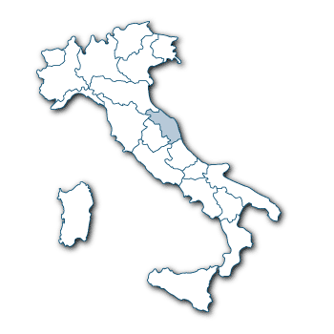
General description of the Volunteering on the Marche Region
Data 2012
1620 voluntary organization (VO)
About 1 VO every 1000 inhabitants
6% of voluntary organization
(approximately 100 VO) are involved in
work with migrants and intercultural topic

Slide 5
financial resources of the CSV

Slide 6
ACTIVITY
Services
Training
Networking
Counselling
Promotion
Projects
Communication
Research

Slide 7

Services
At CSV offices volunteering organization have free access to conference-room, fax, phone, photocopy, computer, printer and so on. Volunteering organizations can borrow some of these in order to realize their activities. It offers qualified counselling and support as well as instruments for the planning, set up and running of specific activities.

Slide 8

Training
CSV organizes training and qualification programmes for members of voluntary organizations. On one hand it realizes courses about a topical subject or problems involving volunteering world. On the other hand it supports training programmes proposed by one or more volunteering organization

Slide 9

Projects
Europe Help-desk, training, detection of funding sources, search for partners, working groups, tutoring and technical help for planning, management and accounting.
direct participation of the CSV as the party leader or member of proposed projects on national and European calls for proposals, through which engage in the process of implementing the activities of voluntary organizations

Slide 10

Research
CSV has a library with books, newspaper and review on the topic of volunteering, social problems, health, handicap, peace, cooperation, no-profit. The access is free for volunteering organizations. Moreover CSV realizes research projects on the topics of interest for volunteering organizations and to collect data on volunteering.

Slide 11

Communication
CSV Marche has a web site (www.csv.marche.it), a facebook a page, a newsletter and an info-sms service through which communicate with organizations and volunteers.

Slide 12

Promotion
CSV promotes the diffusion, the growth and the quality of volunteering and of solidarity through projects for students and young people, public events, information, contacts with local industrial system

Slide 13

Networking
Aiming at a more mature participation of the volunteering world and a more attention to social needs CSV does a networking with the organizations on the territory. Networking is an important tool and instrument for a political and cultural role of volunteering. Another aim of networking is to join us public and third sector.

Slide 14

Counselling
CSV provides support and counselling on administrative and labour law, insurance, found raising, community service and so on. Moreover it is possible to obtain a specific counselling for problems that depend on volunteering organizations 'sector. CSV provides free support for economic and social accounting.

Slide 15

Projects
CSV provides the following services:
- Support for projects which have an impact on the territory supplying information and economic help to the volunteering organizations.
- Information about local, national and European projectual announcements and help in the ideas drawing up

Slide 16
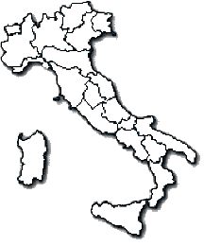
Immigration in Italy. Highlights

Slide 17
Immigration in Italy. Highlights
Italy confirmed its role as a country of arrival for international migration, especially since the beginning of the 21st century. Even during the crisis period there has been an increase in immigration: the 3.4 million foreign citizens residing in Italy in 2007 have became 4,387,721 in 2012, equal to 7.4% of the total Italian population. In the same period, non-EU residents increased from 2.6 million to 3,764,236; according to estimates of the Dossier, the total amount of regular immigrants increased from 3,982,000 to 5,186,000 people.
Increase 2011- 2012: +8,2%

Slide 18
Immigration in Italy. Highlights
As regards the continental origin of foreign citizens regularly residing in Italy, according to estimates by the Dossier, Europe prevails with 50.3% of the total, followed by Africa (22.2%), Asia (19.4%), America (8.0%) and Oceania (0.1%). (16.9%)

Slide 19
Immigration in Italy. Highlights
North 61,8%
Centre 24,2%
South 14,0%
Among the areas of residence, the most preferred ones are in the Northern (61.8%) and Central (24.2%) Italy, whereas the provinces of Milan and Rome hold one-sixth of the total residents (16.9%)

Slide 20
Immigration in Italy. Highlights
Even during the years of the crisis (2008-2012) the employment rate of immigrants increased, in both absolute and percentage terms; while the number of employed Italians decreased by almost 1 million people, immigrants increased by 31.4% (from 1.75 to 2.3 million and even more, when counting seasonal workers and those who live with their employer), reaching nearly 10% of the total employed population, although the majority is employed in low-skill jobs not sought after by the Italians.
Agricolture | 4,9%
Industry | 33,0%
Service | 62,1%

Slide 21
Immigration in Italy. Highlights
In 2012, one of the main reasons for the growth of the foreign population are the children born in Italy to foreign parents (79,894; they were less than 30,000 in 2000), who are joined by the 26,714 children of mixed couples (who have direct access to the Italian citizenship). Overall, if considering both minors born in Italy and those reunited with their families, the total number of non-EU minors staying in Italy is 908,539 (24.1% of the total), whereas the EU minors should be at least 250,000
786,650 foreign students enrolled in 2012-13 (representing 8.8% of the total and 9.8% of those enrolled at elementary schools). In 2,500 schools (14.6% of the total) foreign students are more than 30% of the total student population

Slide 22
Immigration in Italy. Highlights
Government revenue*
13,3 billion euro
11,9 billion euro
Government expenditure**
Balance :
+1,4 billion euro
* social security contributions, personal income tax revenue, taxes on consumption and oils, other taxes, cost of residence permits.
** health, education, social services, home integration, justice,
contrast of irregularity, social security.

Slide 23
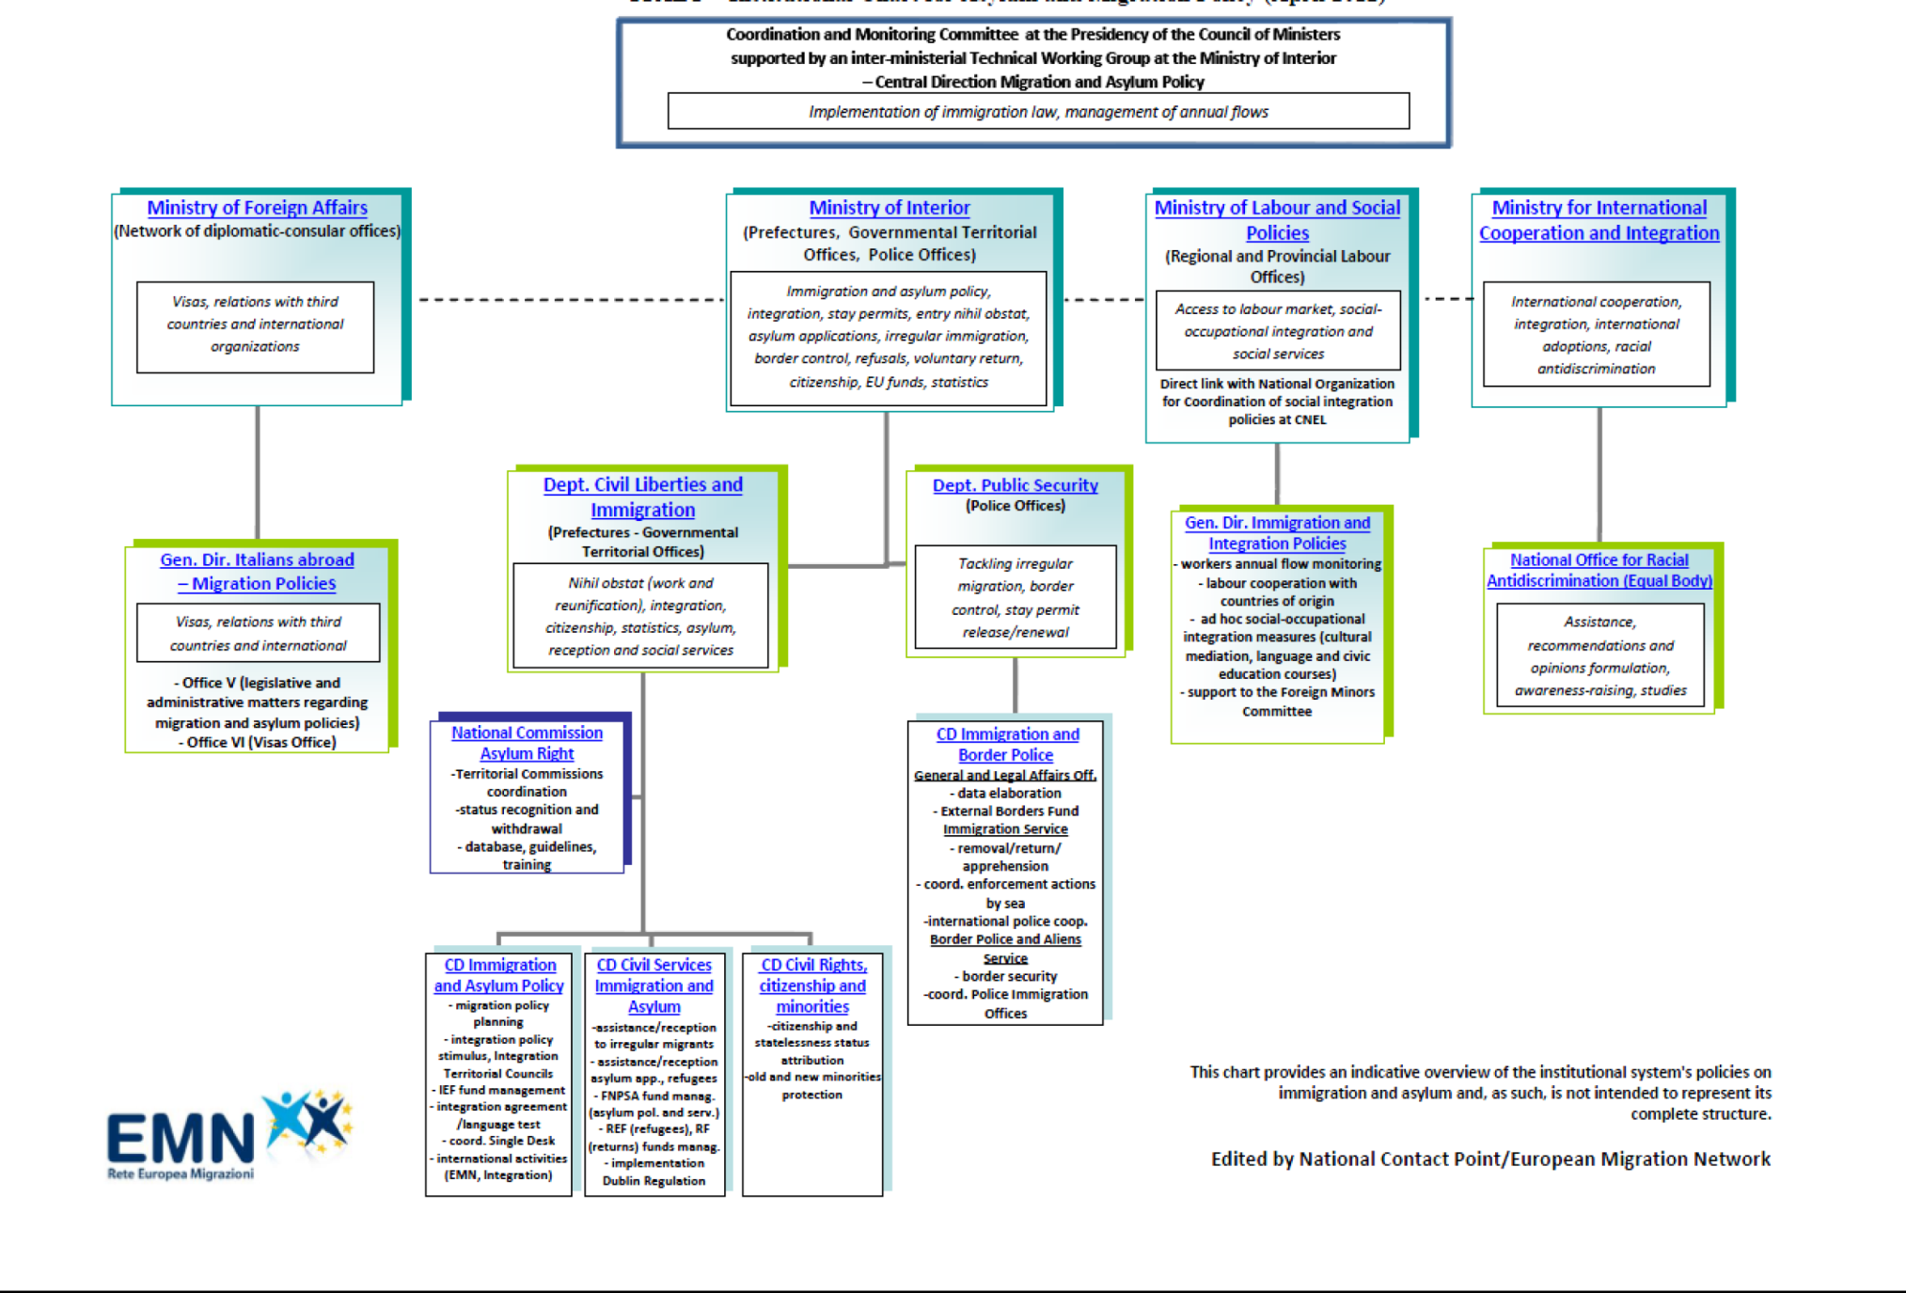

Slide 24

Immigration in Italy. Highlights
The immigrants’ access to social security: an issue of fundamental importance
The Social Security System and access to healthcare are fundamental tools of inclusion, as they provide effective protection against unemployment, accidents at work, sickness and invalidity

Slide 25
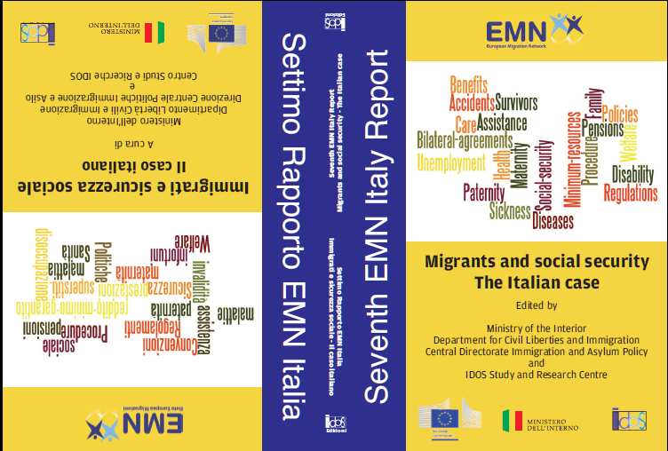

Slide 26
Immigration in Italy. Highlights
According to Italian law, all workers who perform a remunerated activity in the country are compulsorily insured with the social security system, which is financed by insurance contributions paid by employers and workers (both employed and self-employed), as well as by state resources and – for welfare benefits – by national and local public funds
Significant variations exist in the organisation and financing of social security systems in EU Member States

Slide 27
Immigration in Italy. Highlights
In order to qualify for social security benefits like contributory pensions (old-age, disability, invalidity and survivors), unemployment (unemployment benefit, mobility allowance and ordinary redundancy fund), family support (family allowance, maternity leave, parental leave, sick child leave) and health (health-care, sickness cash benefits), foreign citizens must be insured (it is the employer’s obligation to pay contributions).
Immigrant workers residing in Italyare subject to the same legislation on social security and compulsory insurance as Italian workers and are treated equally.

Slide 28
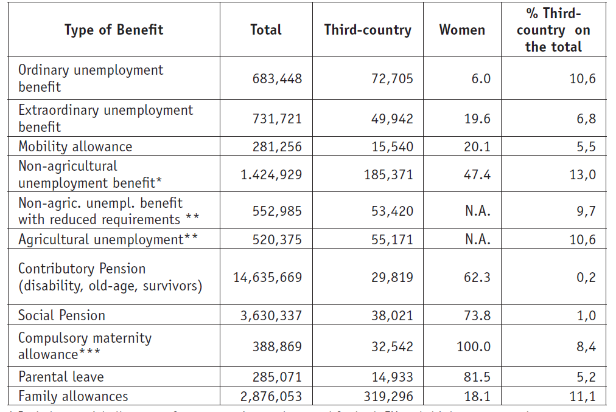
Immigration in Italy. Highlights
Focus on third-country nationals’ access to welfare

Slide 29
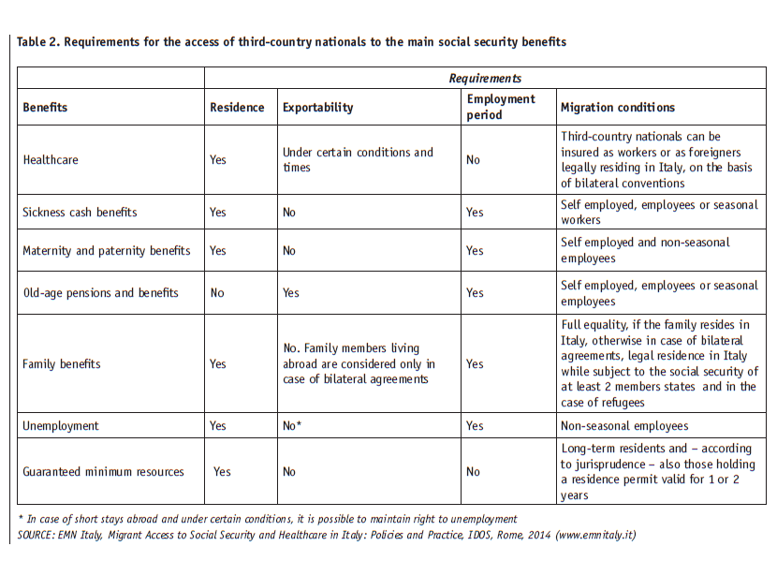

Slide 30
Immigration in Italy. Highlights
Key findings
If, on the one hand, the Italian social security system is universalistic in nature and places foreign workers on an equal basis with Italian workers, on the other hand, the national legislator (sometimes) and the local ones (very often) have actually proposed restrictive laws. This has forced those who work to protect immigrants to engage in a difficult, although often successful effort with various courts, both at the Italian (including the Cassation and Constitutional Courts) and the European level (The Court of Justice in Luxembourg).
The imperfect equal opportunities of the Italian social security system
Equal opportunities are the basis for any immigration policy, this seems not to be the case in Italy regarding the concrete application of welfare measures. However, even for pensions, there are reasons for concern, both for third-country national workers who return to their countries of origin and for those who remain in Italy.

Slide 31
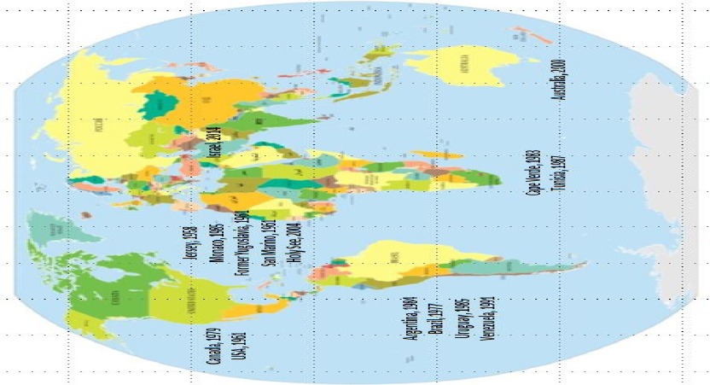
Immigration in Italy. Highlights
Map of bilateral social security agreements (2014)

Slide 32

Thanks for your attention!

